Slide 1
Swings
10 Marks

Slide 2
Course Outcome
Develop programs using GUI Framework[Swing]

Slide 3
Unit Outcomes
Differentiate between AWT and Swing on the given aspect.
Develop Graphical User interface program using swing components for the given problem
Use the given type of button in Java based GUI
Develop GUI using advanced Swing components for the given problem.

Slide 4
Practical Outcome
Write a program using swing to display Scrollpane and JComboBox in JApplet
Write a Java Program to create a JTree
Write a program to create a JTable
Write a Java program to launch JProgressBar

Slide 5
Content..
Introduction to swing:
Swing features
Difference between AWT and Swing
Swing Components
Japplet, Icons and Labels, Text fields, Combo boxes
Buttons:
Jbutton, Checkbox and Radio button
Advanced Swing Components:
Tabbed Panes, Scroll Panes,Trees, Tables ,Progress bar,tool tips
MVC Architecture

Slide 6
Background of Swing
AWT raised the Java popularity bar with powerful GUI features
Significant advancement but could not fulfill the UI needs of programmers
So Swing concept is used to further raise Java standards and popularity.
Swing components are improved alternates to the AWT components by eliminating the limitations and bugs observed in AWT components

Slide 7
Limitations of AWT
AWT components internally depend on native methods like C functions and hence problems related to portability arise
When a component is created in AWT, it internally calls a native method (for example, a C function) that creates the component internally. This component is called 'peer component'.
This means AWT internally depends on C code and this is not desirable as we know that C is a system dependent language.
The appearance of a component is called its 'look' and how the user interacts with the component is called its 'feel'. The look-and-feel of AWT components change depending on the platform (or operating system).
For example, refer code to create a push button in AWT code When this code is executed in Windows it will display windows“ type of push button whereas the same code in Unix will display unix-style of push button. It means when a programmer creates a screen with different components, he cannot be sure how his screen will look on a particular system. Its appearance changes from system to system
Moreover, AWT components are heavy-weight. It means these components take more system resources like more memory and more processor time

Slide 8
Java Foundation Classes (JFC)
Due to these reasons, JavaSoft people felt it better to redevelop AWT package without internally taking the help of native methods. Hence, all the classes of AWT are extended to form new classes and a new class library is created. This library is called JFC (Java Foundation Classes)
JFC is an extension of the original AWT. It contains classes that are completely portable, since the entire JFC is developed in pure Java
Noteworthy features of JFC are as follows
JFC components are light-weight. This means, they utilize minimum system resources. Their speed is comparatively good and hence JFC programs execute much faster
JFC components have same look-and-feel on all platforms. Once a component is created, it looks same on any Operating system. So the programmer can be sure of the look of his screen.
JFC offers 'pluggable look-and-feel' feature, which allows the programmer to change the look and feel as suited for a platform. Suppose, the programmer wants to display Windows-style push buttons on Windows operating system, and Unix-style buttons on Unix, it is possible

Slide 9
Swing Features
Many more built-in controls
Image buttons, tabbed panes, sliders, toolbars, color choosers, text areas, lists, trees, and tables.
Increased customization of components
Border styles, text alignments, and basic drawing features.
Images can be added to almost any control.
A pluggable “look and feel”
Not limited to “native” look.
Many miscellaneous small features
dockable toolbars, keyboard accelerators, custom cursors, etc.
Model-view-controller architecture
Can change internal representation of trees, lists, tables.

Slide 10
Swing Features(cont’d..)
Borders: You can draw borders in many different styles around components using setBorder method
Mouseless: It allows to easily connect keystrokes to the components
Tooltips: You can use setToolTipText method of Jcomponent to give components a tooltip, one of those small windows that appears when the mouse hovers over a component and gives explanatory text
Easy scrolling: You can connect scrolling to various components
New layout manaers: BoxLayout and OverlayLayout
Pluggable look and feel: You can set the appearance of applets and applications to one of the three standard looks: Windows,Unix or Metal
Graphics debugging: You can use the setDebuggingGraphicsOptions method to set up graphics debugging
Icons: Many Swing components can display icons. Usually, icons are implemented as instances of the ImageIcon class

Slide 11
MVC Architecture
In general, a visual component is a collection of 3 distinct aspects/things:
• The way that the component looks when design on the screen.→ view
• The way that the component reacts to the user. → controller
• The state information associated with the component.→ model
For example, in the case of a check box,
the model contains a field that indicates if the box is checked or unchecked.
The view determines how the component is displayed on the screen, including any aspects of the view that are affected by the current state of the model.
The controller determines how the component reacts to the user.
For example, when the user clicks a check box, the controller reacts by changing the model to reflect the user’s choice (checked or unchecked). This then results in the view being updated

Slide 12
MVC Architecture (cont’d..)
The goal of the MVC architecture is to separate the application object (model), its "representation to the user (view), and the way it is controlled by the user (controller).
Although the MVC architecture and the principles behind it are conceptually sound, the high level of separation between the view and the controller is not beneficial for Swing components.
Instead, Swing uses a modified version of MVC that combines the view and the controller into a single logical entity called the UI delegate.
For this reason, Swing’s approach is called either the Model-Delegate architecture or the Separable Model architecture.
Therefore, although Swing’s component architecture is based on MVC, it does not use a classical implementation of it

Slide 13
MVC Architecture (cont’d..)
Swing’s pluggable look and feel is made possible by its Model-Delegate architecture.
Because the view (look) and controller (feel) are separate from the model, the look and feel can be changed without affecting how the component is used within a program.
Conversely, it is possible to customize the model without affecting the way that the component appears on the screen or responds to user input
To support the Model-Delegate architecture, most Swing components contain two objects.
The first represents the model.
The second represents the UI delegate

Slide 14
AWT vs Swing
No. | Java AWT | Java Swing
1) | AWT components are platform-dependent. | Java swing components are platform-independent.
2) | AWT components are heavyweight. | Swing components are lightweight.
3) | AWT doesn't support pluggable look and feel. | Swing supports pluggable look and feel.
4) | AWT provides less components than Swing. | Swing provides more powerful components such as tables, lists, scrollpanes, colorchooser, tabbedpane etc.
5) | AWT doesn't follows MVC(Model View Controller) where model represents data, view represents presentation and controller acts as an interface between model and view. | Swing follows MVC
6) | No naming convention | All Swing component names begin with a capital J and follow the format JXxx. E.g., JFrame, JPanel, JApplet, JDialog, JButton

Slide 15
Components and Containers
A Swing GUI consists of two key items: components and containers
However, this distinction is mostly conceptual because all containers are also components
The difference between the two is found in their intended purpose: As the term is commonly used, a component is an independent visual control, such as a push button or slider
A container holds a group of components
Thus, a container is a special type of component that is designed to hold other components
Furthermore, in order for a component to be displayed, it must be held within a container.
Thus, all Swing GUIs will have at least one container.
Because containers are components, a container can also hold other containers. This enables Swing to define what is called a containment hierarchy, at the top of which must be a top-level container

Slide 16
Components
In general, Swing components are derived from the JComponent class
JComponent provides the functionality that is common to all component
For example, JComponent supports the pluggable look and feel
JComponent inherits the AWT classes Container and Component
All of Swing’s components are represented by classes defined within the package javax.swing
Notice that all component classes begin with the letter J. For example, the class for a label is JLabel; the class for a push button is JButton; and the class for a scroll bar is JScrollBar

Slide 17
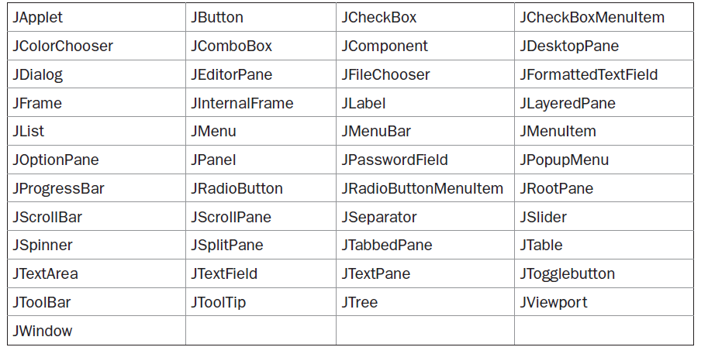
Components(cont’d..)

Slide 19
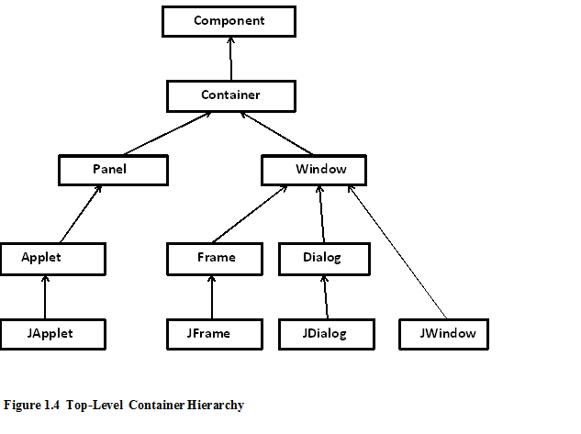

Slide 20
Components(cont’d..)
JApplet - An extended version of java.applet.Applet that adds support for the JFC/Swing component architecture.
Jbutton- An implementation of a "push" button.
JCheckBox - An implementation of a check box -- an item that can be selected or deselected, and which displays its state to the user.
JCheckBoxMenuItem - A menu item that can be selected or deselected.
JColorChooser - JColorChooser provides a pane of controls designed to allow a user to manipulate and select a color.
JComboBox - A component that combines a button or editable field and a drop-down list.
JComponent - The base class for all Swing components except top-level containers.
JDesktopPane - A container used to create a multiple-document interface or a virtual desktop.

Slide 21
JDialog - The main class for creating a dialog window.
JEditorPane - A text component to edit various kinds of content.
JFileChooser - JFileChooser provides a simple mechanism for the user to choose a file.
JFormattedTextField - JFormattedTextField extends JTextField adding support for formatting arbitrary values, as well as retrieving a particular object once the user has edited the text.
JFrame - An extended version of java.awt.Frame that adds support for the JFC/Swing component architecture.
JInternalFrame - A lightweight object that provides many of the features of a native frame, including dragging, closing, becoming an icon, resizing, title display, and support for a menu bar.
JLabel - A display area for a short text string or an image, or both.

Slide 22
JLayeredPane - JLayeredPane adds depth to a JFC/Swing container, allowing components to overlap each other when needed.
JList<E> - A component that displays a list of objects and allows the user to select one or more items.
JMenu - An implementation of a menu -- a popup window containing JMenuItems that is displayed when the user selects an item on the JMenuBar.
JMenuBar - An implementation of a menu bar.
JMenuItem - An implementation of an item in a menu.
JOptionPane - JOptionPane makes it easy to pop up a standard dialog box that prompts users for a value or informs them of something.

Slide 23
JPanel - JPanel is a generic lightweight container.
JPasswordField - JPasswordField is a lightweight component that allows the editing of a single line of text where the view indicates something was typed, but does not show the original characters.
JPopupMenu - An implementation of a popup menu -- a small window that pops up and displays a series of choices.
JProgressBar - A component that visually displays the progress of some task.
JRadioButton - An implementation of a radio button -- an item that can be selected or deselected, and which displays its state to the user.
JRadioButtonMenuItem - An implementation of a radio button menu item.
JRootPane - A lightweight container used behind the scenes by JFrame, JDialog, JWindow, JApplet, and JInternalFrame.
JScrollBar - An implementation of a scrollbar.
JScrollPane - Provides a scrollable view of a lightweight component.

Slide 24

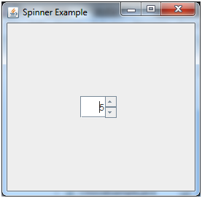
JSeparator - JSeparator provides a general purpose component for implementing divider lines - most commonly used as a divider between menu items that breaks them up into logical groupings.
JSlider - A component that lets the user graphically select a value by sliding a knob within a bounded interval.
JSpinner - A single line input field that lets the user select a number or an object value from an ordered sequence.

Slide 25
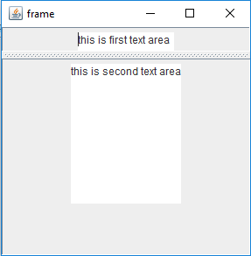
JSplitPane - JSplitPane is used to divide two (and only two) Components.

Slide 26
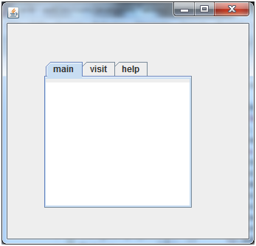
JTabbedPane - A component that lets the user switch between a group of components by clicking on a tab with a given title and/or icon.
JTable - The JTable is used to display and edit regular two-dimensional tables of cells.

Slide 27
JTextArea -A JTextArea is a multi-line area that displays plain text.
JTextField - JTextField is a lightweight component that allows the editing of a single line of text.
JTextPane - JTextPane is a subclass of JEditorPane class. JTextPane is used for styled document with embedded images and components.
JToggleButton - An implementation of a two-state button.
JToolBar - JToolBar provides a component that is useful for displaying commonly used Actions or controls.
JToolTip - Used to display a "Tip" for a Component.
JTree - A control that displays a set of hierarchical data as an outline.

Slide 28
Containers
Swing defines two types of containers.
Top-level containers:
JFrame, JApplet,JWindow, and JDialog.
These containers do not inherit Jcomponent
They do, however,inherit the AWT classes Component and Container
Unlike Swing’s other components,which are lightweight, the top-level containers are heavyweight
As the name implies, a top-level container must be at the top of a containment hierarchy.
A top-level container is not contained within any other container
Furthermore, every containment hierarchy must begin with a top-level container.
The one most commonly used for applications is JFrame. The one used for applets is JApplet

Slide 29
Containers(cont’d..)
Lightweight Containers:
Lightweight containers do inherit JComponent.
An example of a lightweight container is JPanel, which is a general-purpose container.
Lightweight containers are often used to organize and manage groups of related components because a lightweight container can be contained within another container.
Thus, you can use lightweight containers such as JPanel to create subgroups of related controls that are contained within an outer container

Slide 30
Top-Level Container Panes
Each top-level container defines a set of panes.
At the top of the hierarchy is an instance of JRootPane.
JRootPane is a lightweight container whose purpose is to manage the other panes.
It also helps manage the optional menu bar.
The panes that comprise the root pane are called the glass pane, the content pane, and the layered pane

Slide 31
Root Pane
When you look at any window in a computer, the outer part containing the minimize, restore and close buttons and the overall border can be thought of as a frame.
The frame that we are imaging is still hollow!
That means there is nothing in the middle.
So, the frame is similar to a real-life photo frame
When we create a JFrame object, a JRootPane is automatically created and it occupies the empty part of the frame
So, the JRootPane is like the base of the photo frame. This means that all the content in the frame should lie on top of it
Now the JRootPane has two children. There is an optional MenuBar and a ContentPane

Slide 32
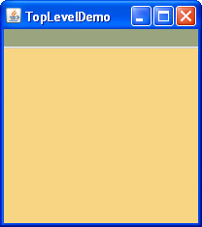
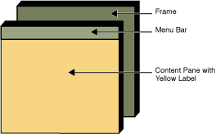

Slide 33
Content Pane
The menu bar occupies the upper part while the rest of the part is used by the ContentPane
As the name suggests, all the contents that we might add will be placed on the ContentPane
Hence, the ContentPane is very similar to the photograph in the photo frame
It holds the visible content.
Whenever we add a component to a JFrame using a method like frame.add(component) the ContentPane is implicitly called and the component is added to it
As the ContentPane has no default layout, the component takes up the entire area of the component pane
In case we add a new component, the old component is overlapped by the new one

Slide 34
Content pane(cont’d..)
Although the glass pane and the layered panes are integral to the operation of a top-level container and serve important purposes, much of what they provide occurs behind the scene.
The pane with which your application will interact the most is the content pane, because this is the pane to which you will add visual components.
In other words, when you add a component, such as a button, to a top-level container, you will add it to the content pane.
By default, the content pane is an opaque instance of JPanel

Slide 35
Glass pane
It covers the entire visible area of the root pane.
The glass pane is the top-level pane. It sits above and completely covers all other panes
It behaves just like a sheet of glass and is completely transparent unless we implement the glass pane’s paintComponent method.
The glass pane enables you to manage mouse events that affect the entire container (rather than an individual control) or to paint
It is similar to the glass on the photo frame which is invisible and lies on top of the photograph
In most cases, you won’t need to use the glass pane directly, but it is there if you need it

Slide 36
Layered pane
The layered pane is an instance of JLayeredPane.
The layered pane allows components to be given a depth value.
This value determines which component overlays another. (Thus, the layered pane lets you specify a Z-order for a component, although this is not something that you will usually need to do.)
The layered pane holds the content pane and the (optional)menu bar.

Slide 37
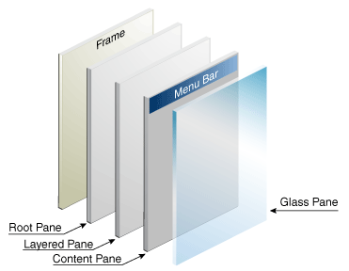

Slide 38
JApplet
An extended version of java.applet.Applet that adds support for the JFC/Swing component architecture

Slide 39
JLabel
A display area for a short text string or an image, or both. A label does not react to input events. As a result, it cannot get the keyboard focus.
Constructor and Description
JLabel()
Creates a JLabel instance with no image and with an empty string for the title.
JLabel(Icon image)
Creates a JLabel instance with the specified image.
JLabel(Icon image, int horizontalAlignment)
Creates a JLabel instance with the specified image and horizontal alignment.
JLabel(String text)
Creates a JLabel instance with the specified text.
JLabel(String text, Icon icon, int horizontalAlignment)
Creates a JLabel instance with the specified text, image, and horizontal alignment.
JLabel(String text, int horizontalAlignment)
Creates a JLabel instance with the specified text and horizontal alignment.

Slide 40
Icon getIcon()
Returns the graphic image (glyph, icon) that the label displays.
int getIconTextGap()
Returns the amount of space between the text and the icon displayed in this label.
String getText()
Returns the text string that the label displays.
void setHorizontalAlignment(int alignment)
Sets the alignment of the label's contents along the X axis.
void setHorizontalTextPosition(int textPosition)
Sets the horizontal position of the label's text, relative to its image.
void setIcon(Icon icon)
Defines the icon this component will display.
void setIconTextGap(int iconTextGap)
If both the icon and text properties are set, this property defines the space between them.

Slide 41
void setText(String text)
Defines the single line of text this component will display.
void setVerticalAlignment(int alignment)
Sets the alignment of the label's contents along the Y axis.
void setVerticalTextPosition(int textPosition)
Sets the vertical position of the label's text, relative to its image.

Slide 42
ImageIcon
public class ImageIcon extends Object implements Icon
An implementation of the Icon interface that paints Icons from Images.
Images that are created from a URL, filename or byte array are preloaded using MediaTracker to monitor the loaded state of the image.
ImageIcon(String filename)
Creates an ImageIcon from the specified file.
int getIconHeight()
Gets the height of the icon.
int getIconWidth()
Gets the width of the icon.
Image getImage()
Returns this icon's Image.
void setImage(Image image)
Sets the image displayed by this icon.

Slide 43
setBounds()
The setBounds() method not only specifies the size of the frame, but the location of the upper left corner:
public void setBounds(int x, int y, int width, int height)
This puts the upper left corner at location (x, y), where x the the number of pixels from the left of the screen and y is is the number from the top of the screen. height and width are as before.

Slide 44
Border & BorderFactory
Border
Interface describing an object capable of rendering a border around the edges of a swing component.
public class BorderFactory extends Object
static Border createLineBorder(Color color)
Creates a line border withe the specified color.
static Border createLineBorder(Color color, int thickness)
Creates a line border with the specified color and width.
static Border createLineBorder(Color color, int thickness, boolean rounded)
Creates a line border with the specified color, thickness, and corner shape.

Slide 45
JComboBox
public class JComboBox<E> extends JComponent
A component that combines a button or editable field and a drop-down list.
The user can select a value from the drop-down list, which appears at the user's request.
JComboBox()
Creates a JComboBox with a default data model.
JComboBox(ComboBoxModel<E> aModel)
Creates a JComboBox that takes its items from an existing ComboBoxModel.
JComboBox(E[] items)
Creates a JComboBox that contains the elements in the specified array.
JComboBox(Vector<E> items)
Creates a JComboBox that contains the elements in the specified Vector.

Slide 46
void addItem(E item)
Adds an item to the item list.
E getItemAt(int index)
Returns the list item at the specified index.
int getItemCount()
Returns the number of items in the list.
void insertItemAt(E item, int index)
Inserts an item into the item list at a given index.
void removeAllItems()
Removes all items from the item list.
void removeItem(Object anObject)
Removes an item from the item list.
void removeItemAt(int anIndex)
Removes the item at an Index This method works only if the JComboBox uses a mutable data model.

Slide 47
JTextField
public class JTextField extends JTextComponent
JTextField is a lightweight component that allows the editing of a single line of text.
JTextField()
Constructs a new TextField with string as null and no. of column 0.
JTextField(int columns)
Constructs a new empty TextField with the specified number of columns.
JTextField(String text)
Constructs a new TextField initialized with the specified text.
JTextField(String text, int columns)
Constructs a new TextField initialized with the specified text and columns.

Slide 48
JTextArea
public class JTextArea extends JTextComponent
A JTextArea is a multi-line area that displays plain text.

Slide 49
JButton
Buttons are simple UI components used to generate events when the user presses them. Swing buttons can display icons, text, or both.
In this section AbstractButton is an abstract base class for all button components (JButton, JToggleButton, JCheckBox, JRadioButton, and JMenuItem and its subclasses).
AbstractButton provides much of the functionality associated with the interaction between the various concrete
button classes and their ButtonModel objects.
As we mentioned earlier, buttons in Swing can be made up of an image (Icon ), text, or both. The relative positions of the text and icon are specified exactly as they are with the JLabel class.

Slide 50
JToggleButton
A JToggleButton is a two-state button. The two states are selected and unselected.
The JRadioButton and JCheckBox classes are subclasses of this class.
When the user presses the toggle button, it toggles between being pressed or unpressed.
JToggleButton is used to select a choice from a list of possible choices.
Buttons can be configured, and to some degree controlled, by Actions. Using an Action with a button has many benefits beyond directly configuring a button.

Slide 51
JToggleButton(cont’d)
Constructors in JToggleButton:
JToggleButton(): Creates an initially unselected toggle button without setting the text or image.
JToggleButton(Icon icon): Creates an initially unselected toggle button with the specified image but no text.
JToggleButton(Icon icon, boolean selected): Creates a toggle button with the specified image and selection state, but no text.
JToggleButton(String text): Creates an unselected toggle button with the specified text.
JToggleButton(String text, boolean selected): Creates a toggle button with the specified text and selection state.
JToggleButton(String text, Icon icon): Creates a toggle button that has the specified text and image, and that is initially unselected.
JToggleButton(String text, Icon icon, boolean selected):Creates a toggle button with the specified text, image, and selection state.

Slide 52
JCheckBox
JCheckBox can be selected or deselected .
It displays it state to the user .
JCheckBox inherits JToggleButton class.
public class JCheckBox extends JToggleButton
Constructor of the class are :
JCheckBox() : creates a new checkbox with no text or icon
JCheckBox(Icon i) : creates a new checkbox with the icon specified
JCheckBox(Icon icon, boolean s) :
JCheckBox(String t) :creates a new checkbox with the string specified
JCheckBox(String text, boolean selected) :
JCheckBox(String text, Icon icon) :
JCheckBox(String text, Icon icon, boolean selected):

Slide 53
setIcon(Icon i) : sets the icon of the checkbox to the given icon
setText(String s) :sets the text of the checkbox to the given text
setSelected(boolean b) : sets the checkbox to selected if boolean value passed is true or vice versa
getIcon() : returns the image of the checkbox
getText() : returns the text of the checkbox

Slide 54
JRadioButton
The JRadioButton class is used to create a radio button. It is used to choose one option from multiple options. It is widely used in exam systems or quiz.
It should be added in ButtonGroup to select one radio button only.
public class JRadioButton extends JToggleButton
Constructor | Description
JRadioButton() | Creates an unselected radio button with no text.
JRadioButton(String s) | Creates an unselected radio button with specified text.
JRadioButton(String s, boolean selected) | Creates a radio button with the specified text and selected status.

Slide 55
void setText(String s) | It is used to set specified text on button.
String getText() | It is used to return the text of the button.
void setEnabled(boolean b) | It is used to enable or disable the button.
void setIcon(Icon b) | It is used to set the specified Icon on the button.
Icon getIcon() | It is used to get the Icon of the button.

Slide 56
JTabbedPane
JTabbedPane encapsulates a tabbed pane.
It manages a set of components by linking them with tabs.
Selecting a tab causes the component associated with that tab to come to the forefront.
Tabbed panes are very common in the modern GUI.
A component that lets the user switch between a group of components by clicking on a tab with a given title and/or icon
JTabbedPane defines three constructors.
JTabbedPane()
Creates an empty TabbedPane with a default tab placement of JTabbedPane.TOP.
JTabbedPane(int tabPlacement)
Creates an empty TabbedPane with the specified tab placement of either: JTabbedPane.TOP, JTabbedPane.BOTTOM, JTabbedPane.LEFT, or JTabbedPane.RIGHT.
JTabbedPane(int tabPlacement, int tabLayoutPolicy)
Creates an empty TabbedPane with the specified tab placement and tab layout policy.
Component add(String title, Component component)
void addTab(String title, Component component)

Slide 57
JTable
JTable is a component that displays rows and columns of data.
We can drag the cursor on column boundaries to resize columns. We can also drag a column to a new position.
Jtable is used to display or edit two-dimensional data that is having both rows and columns
JTable(): A table is created with empty cells.
JTable(int rows, int cols): Creates a table of size rows * cols.
JTable(Object[][] data, Object []Column): A table is created with the specified name where []Column defines the column names.

Slide 58
methods
void addColumn(TableColumn aColumn)
Appends aColumn to the end of the array of columns held by this JTable's column model.
void clearSelection()
Deselects all selected columns and rows.
boolean editCellAt(int row, int column)
Programmatically starts editing the cell at row and column, if those indices are in the valid range, and the cell at those indices is editable.
TableColumn getColumn(Object identifier)
Returns the TableColumn object for the column in the table whose identifier is equal to identifier, when compared using equals.

Slide 59
int getColumnCount()
Returns the number of columns in the column model.
String getColumnName(int column)
Returns the name of the column appearing in the view at column position column.
int getRowCount()
Returns the number of rows that can be shown in the JTable, given unlimited space.
int getSelectedColumn()
Returns the index of the first selected column, -1 if no column is selected.
int getSelectedColumnCount()
Returns the number of selected columns.
int[] getSelectedColumns()
Returns the indices of all selected columns.

Slide 60
int getSelectedRow()
Returns the index of the first selected row, -1 if no row is selected.
int getSelectedRowCount()
Returns the number of selected rows.
int[] getSelectedRows()
Returns the indices of all selected rows.
boolean isCellEditable(int row, int column)
Returns true if the cell at row and column is editable.
boolean isCellSelected(int row, int column)
Returns true if the specified indices are in the valid range of rows and columns and the cell at the specified position is selected.
boolean isColumnSelected(int column)
Returns true if the specified index is in the valid range of columns, and the column at that index is selected.

Slide 61
boolean isEditing()
Returns true if a cell is being edited.
boolean isRowSelected(int row)
Returns true if the specified index is in the valid range of rows, and the row at that index is selected.
void moveColumn(int column, int targetColumn)
Moves the column column to the position currently occupied by the column targetColumn in the view.
void removeColumn(TableColumn aColumn)
Removes aColumn from this JTable's array of columns.

Slide 62
JScrollPane
JScrollPane is a lightweight container that automatically handles the scrolling of another component.
If the object being scrolled is larger than the viewable area, horizontal and/or vertical scroll bars are automatically provided, and the component can be scrolled through the pane.
Because JScrollPane automates scrolling, it usually eliminates the need to manage individual scroll bars.
The viewable area of a scroll pane is called the viewport.
It is a window in which the component being scrolled is displayed. Thus, the viewport displays the visible portion of the component being scrolled.
The scroll bars scroll the component through the viewport. In its default behavior, a JScrollPane will dynamically add or remove a scroll bar as needed.
JScrollPane(Component comp)

Slide 63
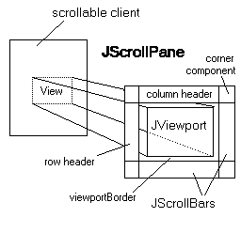
Note that JScrollPane does not support heavyweight components.
The following text describes this image:
The JViewport provides a window, or "viewport" onto a data source -- for example, a text file. A JScrollPane basically consists of JScrollBars, a JViewport, and the wiring between them, as shown in the diagram at right.

Slide 64
Constructors
JScrollPane()
Creates an empty (no viewport view) JScrollPane where both horizontal and vertical scrollbars appear when needed.
JScrollPane(Component view)
Creates a JScrollPane that displays the contents of the specified component, where both horizontal and vertical scrollbars appear whenever the component's contents are larger than the view.
JScrollPane(Component view, int vsbPolicy, int hsbPolicy)
Creates a JScrollPane that displays the view component in a viewport whose view position can be controlled with a pair of scrollbars.
VERTICAL_SCROLLBAR,VERTICAL_SCROLLBAR_AS_NEEDED,VERTICAL_SCROLLBAR_ALWAYS,VERTICAL_SCROLLBAR_NEVER
JScrollPane(int vsbPolicy, int hsbPolicy)
Creates an empty (no viewport view) JScrollPane with specified scrollbar policies.

Slide 65
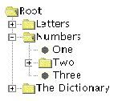
JTree
JTree is a Swing component with which we can display hierarchical data.
JTree is quite a complex component.
A JTree has a 'root node' which is the top-most parent for all nodes in the tree.
A node is an item in a tree.
A node can have many children nodes.
These children nodes themselves can have further children nodes.
If a node doesn't have any children node, it is called a leaf node.
The leaf node is displayed with a different visual indicator.
The nodes with children are displayed with a different visual indicator along with a visual 'handle' which can be used to expand or collapse that node.
Expanding a node displays the children and collapsing hides them.

Slide 66
Declaration:
public class JTree extends Jcomponent
Constructor:
JTree(TreeNode root)
Returns a JTree with the specified TreeNode as its root, which displays the root node.
TreeNode is an Interface present in package javax.swing.tree
A TreeNode instance represents an object which can have multiple children nodes but has only one parent node.
The root node has null parent.
This interface has only getters to get information about this or children or parent nodes, thus it represents an immutable node.
Subinterfaces is MutableTreeNode and implementing Classes is DefaultMutableTreeNode
This is a subinterface of TreeNode, which represents a mutable node. This interface additionally introduces methods to insert and remove nodes.

Slide 67
DefaultMutableTreeNode is an implementation of MutableTreeNode which represents a general-purpose node.
This class is provided in the Swing API and we can use it to represent our nodes. This class has a handy add() method which takes in an instance of MutableTreeNode.
Example:
We want to display the list of vegetables and fruits hierarchically.
So, we will first create the root node. And then we can recursively add nodes to that root.
When we create the JTree instance, we just pass the root node instance. This is because, the root node contains all the information including the children

Slide 68
JProgressBar
JProgressBar visually displays the progress of some specified task.
JProgressBar shows the percentage of completion of specified task.
The progress bar fills up as the task reaches it completion.
In addition to show the percentage of completion of task, it can also display some text .
Constructors of JProgressBar :
JProgressBar() :
Creates a horizontal progress bar that displays a border but no progress string. The initial and minimum values are 0, and the maximum is 100
JProgressBar(int orientation) :
Creates a progress bar with the specified orientation, which can be either SwingConstants.VERTICAL or SwingConstants.HORIZONTAL. By default, a border is painted but a progress string is not. The initial and minimum values are 0, and the maximum is 100

Slide 69
JProgressBar(int min, int max) :
Creates a horizontal progress bar with the specified minimum and maximum. Sets the initial value of the progress bar to the specified minimum. By default, a border is painted but a progress string is not
JProgressBar(int orientation, int min, int max) :
Creates a progress bar using the specified orientation, minimum, and maximum. By default, a border is painted but a progress string is not. Sets the initial value of the progress bar to the specified minimum

Slide 70
Commonly used methods of JProgressBar are :
int getMaximum() : returns the progress bar’s maximum value.
int getMinimum() : returns the progress bar’s minimum value.
String getString() : get the progress bar’s string representation of current value.
void setMaximum(int n) : sets the progress bar’s maximum value to the value n.
void setMinimum(int n) : sets the progress bar’s minimum value to the value n.
void setValue(int n) : set Progress bar’s current value to the value n.
void setString(String s) : set the value of the progress String to the String s.

Slide 71
Tool tip
We can add tooltip text to almost all the components of Java Swing by using the following method setToolTipText(String s).
This method sets the tooltip of the component to the specified string s .
When the cursor enters the boundary of that component a popup appears and text is displayed .
Methods used:
getToolTipText() : returns the tooltip text for that component .
setToolTipText(String s) : sets the tooltip text for the component .
getToolTipLocation(MouseEvent e) : Returns the location (in the receiving component’s coordinate system) where the upper left corner of the component’s tool tip appears.

